Slide 1
Selecting the best location for a Restaurant
By Samuel Schatz

Slide 2
Selecting a location is vital for a Restaurants Success
A location is normally the first thing Restaurant owners think about when they are about to open up a Restaurant.
This is because it determine the traffic that comes into the Restaurant.
It also affects the community around it by:
Bringing money into the community
Providing jobs for the community
Brings tax money into the community

Slide 3
Data sources and cleaning
Latitude and Longitude for each city I got it from the GeoHack tool, this is used in the mapping of the restaurants and other tools.
Population data I got it from Wikipedia are cities or counties.
Population statistics and Restaurant info I got from FourSquare
Restaurant Price Rating I got that using Google's Places API
The last data source was uszipcode · PyPI package which gave me information about the zip code.
For data cleaning I got rid of the appropriate data.

Slide 4
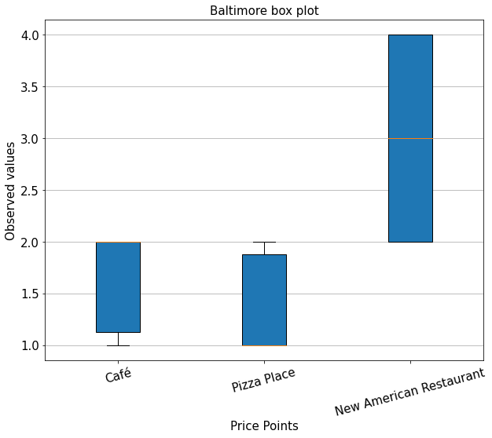
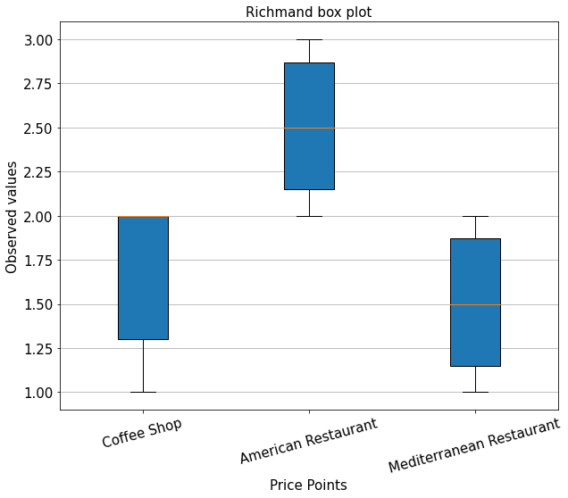
Price Point of Restaurant Category per city: Part 1

Slide 5
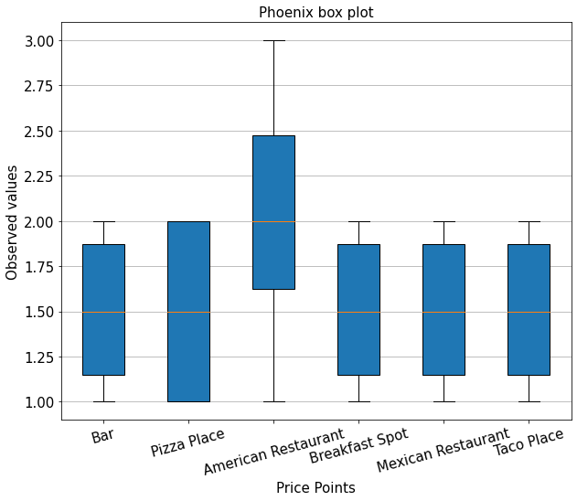
Price Point of Restaurant Category per city: Part 2

Slide 6
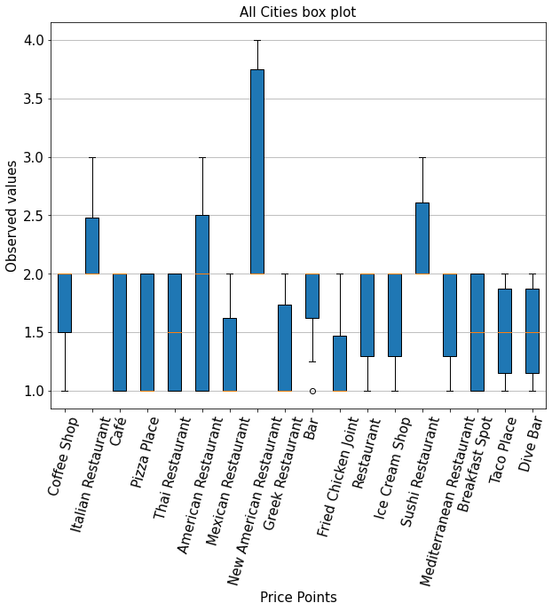
Price Point of Restaurant Category: All

Slide 7
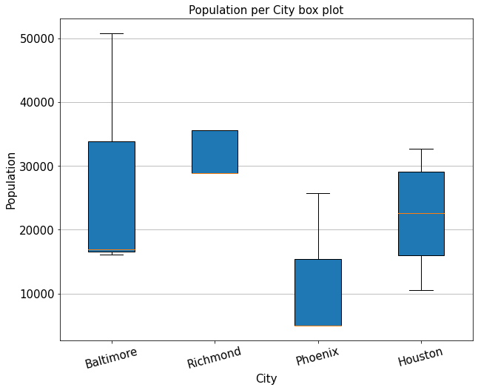
Population of each city:

Slide 8
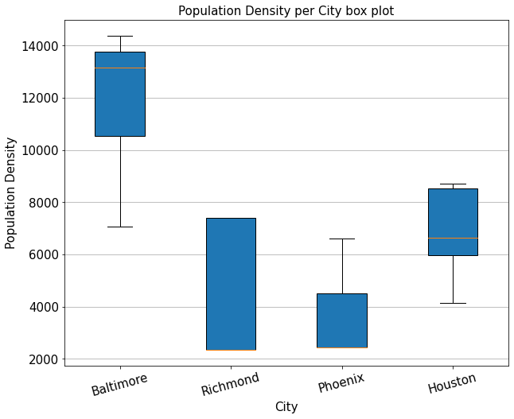
Population Density of each city:

Slide 9
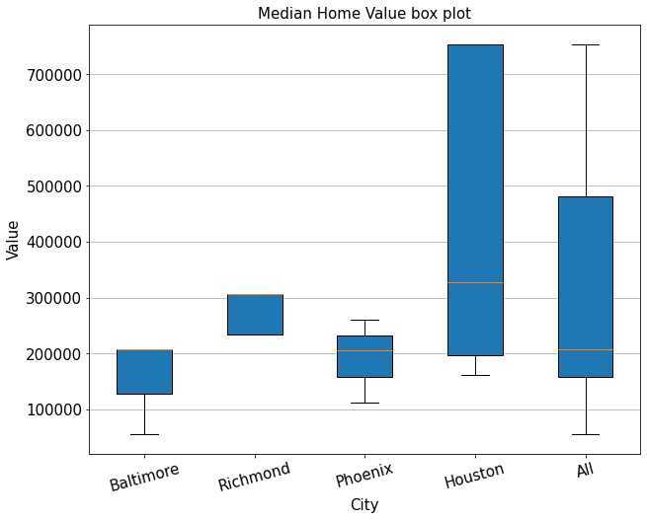
Median Home Value:

Slide 10
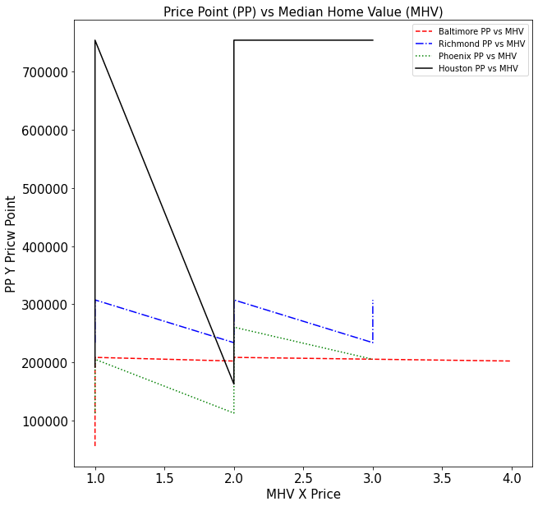
Price Point (PP) vs Median Home Value (MHV):

Slide 11
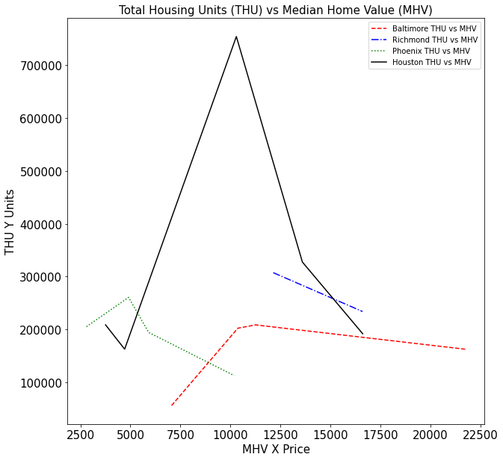
Total Housing Units (THU) vs Median Home Value (MHV):

Slide 12
Conclusion:
Analyzed factors that a restaurant owner would take into consideration when opening a restaurant.
Identified many factors such as; Price Point, Population, Population Density, and many housing and income factors.
These graphs and data can be used to make a decision in which of the four cities to open a restaurant.

